Slide 1
MSc Project
(CMP060L050S)
Mid-Point Review Presentation
Title:Traffic Forecasting For Road Network
Subtitle: Optimizing Routes in London and University of Roehampton
Student Name: Uzum Stanley Ekene
Supervisor Name: Dr. Jose Paredes

Slide 2
Outline
context​
problematic statement​
objectives ​
methodology​
project management​
literature review​
next steps

Slide 3
Context
Introduction:
•Traffic congestion and navigation inefficiency are significant issues in metropolitan areas like London. Addressing these problems can save time and reduce economic losses. According to the INRIX 2022 Global Traffic Scorecard, it cost the average driver in London £1,377 on account of lost time to congestion. Across the UK, the drivers, on average, lost £707 in time1. Also, the annual cost of fuelling a car for the average commuter in London went up by more than; claims AdapterView £212. Nationally, Britons spend £122, which was more at the pump to commute1. These numbers reflect the direct economic cost of traffic congestion in the context of the importance of effective traffic management and forecasting. In so doing, cities can reduce such economic losses and make life more productive.
•This project aims to develop a system that provides optimal routes for travelers within London and aids in effortless navigation within the University of Roehampton campus.

Slide 4
Problem Statement (Why)
What is the problem?​
Traffic congestion in London leads to significant time and economic losses.​
Navigating the University of Roehampton campus is challenging for newcomers.
Who is affected?
London drivers and commuters.
Students and visitors at the University of Roehampton.
Where/When does it occur?
In London during peak travel times.
Throughout the year at the University of Roehampton, particularly during the start of semesters.
Why is it important?
Congestion increases travel costs and time, impacting quality of life and productivity.
Efficient campus navigation enhances the experience for students, newly employed staff members
and visitors.

Slide 5
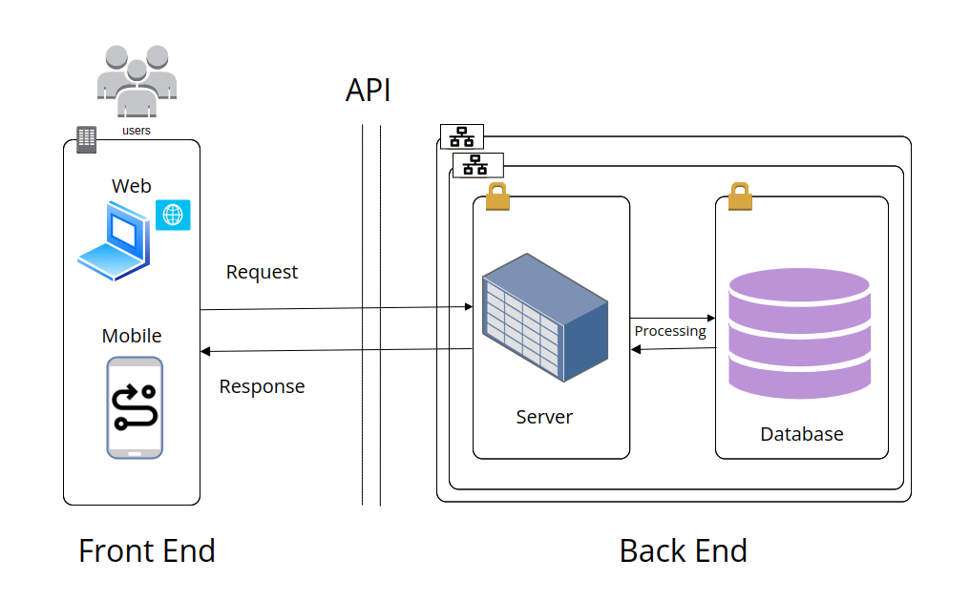
Objective - WHAT
The primary aim of this research is to develop an optimized navigation system for London Road Network and University of Roehampton campus using a path-finding algorithm. The specific objectives are:
To map the London route network as a graph incorporating both drivable roads and footpaths
Develop a system to effectively implement a path-finding algorithm to improve navigation efficiency.
To design a user-friendly web interface for the navigation system.

Slide 6
Methodology - HOW
Data Collection
Obtain London road data from Transport for London (TFL).
Digitize campus routes using Google Earth and Google Maps.
Graph Modeling
The graph network, digitized and cleaned using QGIS and modeled with Python, will visually and data-wise represent the London road network with nodes and edges, ready for further processing..
Graph Densification
The graph will be densified by adding intermediate nodes and refining edges to improve path-finding accuracy and efficiency, resulting in a detailed and accurate road representation.
Path-Finding Algorithm Implementation
Python Dijkstra’s algorithm will be implemented in Python, Go, and JavaScript to calculate the shortest paths on the graph, tested on smaller campus sections before scaling to the entire area.
Validation
The computed paths will be validated by comparing them with real-world navigation scenarios and user tests, where participants follow suggested routes and provide feedback for adjustments to enhance the system's reliability.

Slide 7
System Development
Database Design
A comprehensive database design using PostgreSQL with PostGIS will be developed to efficiently store and manage spatial and attribute data, ensuring robust and scalable data management.
Backend Development
The backend will be developed to handle data processing, pathfinding algorithms, and database interactions by setting up servers, API endpoints, and ensuring secure and efficient data transactions.
Web Development
A web interface using React will be developed to display optimal routes on a digital map of London, designed for accessibility via computers to ensure ease of use for all campus members, providing an interactive and responsive experience.
Integration of Custom Tile Map Service
The application will integrate a custom tile map service for high-resolution drone imagery, ensuring seamless and efficient map rendering for easy user interaction.
Why these methods?
Dijkstra's Algorithm Proven efficiency in shortest path finding.
Widely used for interactive maps with extensive documentation and support.

Slide 8
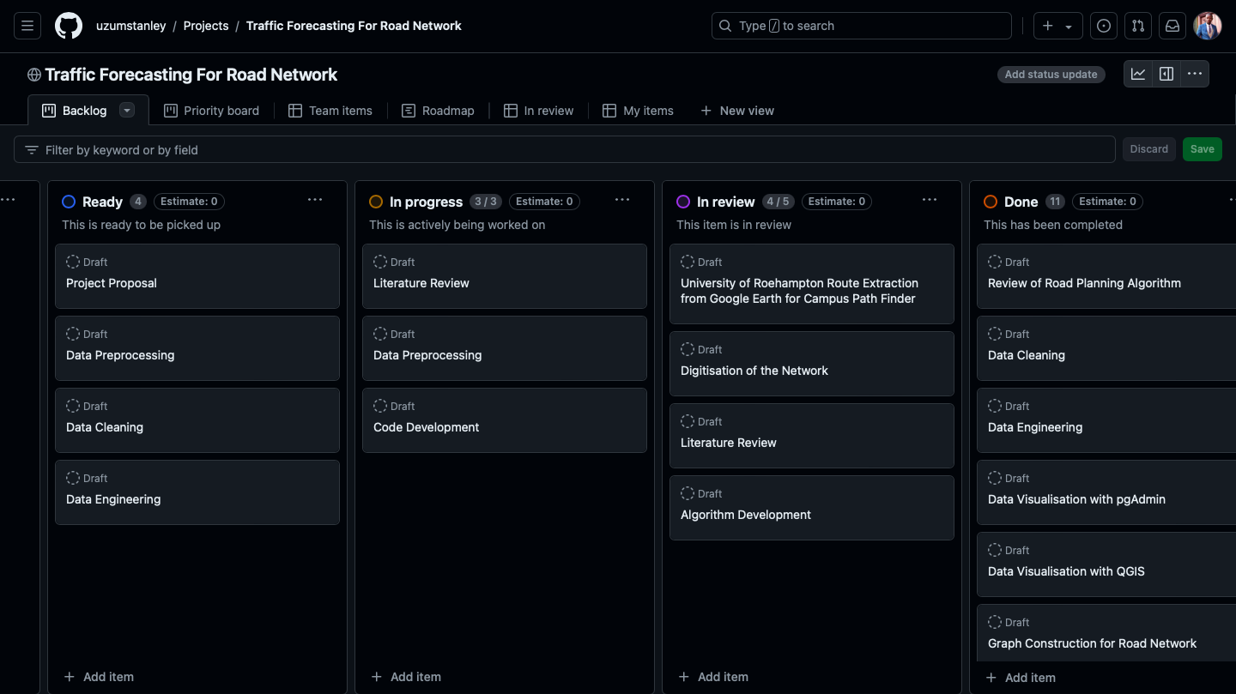
Project Management
https://github.com/users/uzumstanley/projects/1/views/1

Slide 9
Literature Review
Findings.
Dijkstra’s Algorithm: Proven effective for finding shortest paths in graphs. Ideal for navigation in complex environments like university campuses and road networks [2, 3].
Real-World Applications: Successfully used in optimizing campus routes (Botsis & Panagiotopoulos, 2020) and urban networks [1]. Highlights its suitability for detailed, constrained environments.
Limitations of Existing Tools: Generic tools like Google Maps often fail in providing optimal routes for specific layouts and intricate networks [1, 3].
Goal: To reduce traffic congestion by considering shortest route and enhance campus navigation through an optimized, tailored navigation system.

Slide 10
Next Steps
I have completed 60% of the project, including data cleaning, graph construction, and database integration. With 4 weeks remaining, I need to finalize backend and frontend development. I am 95% proficient in managing the project and currently face no issues, having resolved earlier data acquisition challenges using Google Earth and QGIS.
References:
[1] K. Botsis and A. Panagiotopoulos, "Application of Dijkstra’s algorithm for the optimization of routes within the campus of the International Hellenic University," Int. J. Comput. Appl., vol. 175, no. 26, pp. 8–14, 2020.
[2] E. W. Dijkstra, "A note on two problems in connexion with graphs," Numer. Math., vol. 1, pp. 269–271, 1959.
[3] Y. Li, Z. Peng, and Y. Huang, "Simulation of optimal evacuation route planning in primary school based on Dijkstra’s algorithm," J. Saf. Res., vol. 57, pp. 73–78, 2016.

